Slide 1

10th Anniversary Year
Notes:
Are you ready to be Lobbied?
Who we Are? All of us
What is our Mission?
Start off with a Question
How does the forward march of Humanity force groups to redefine their definition of the universe (or God)?
SCA is here to update the definition

Slide 2
Notes:
What caused the religious right movement to surface was Jimmy Carter’s intervention against the Christian schools by attempting to deny them tax-exempt status on the basis of segregation.
In both 1976 and 1980 the Christian Right was slightly less likely to favor the Republican nominee. In 1984 and 1988 it favored the Republican candidate by at least 10 percent. In 1992 and 1996 the Christian Right voted for George Bush and Robert Dole by a 3 to 1 margin.

Slide 3
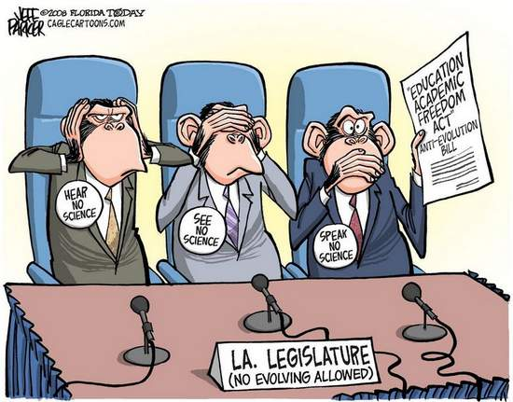
Creationism in Public Schools
Creationism Passed in LA & TN - Fighting in Twelve States
Notes:
Now, instead for fighting against racial integration, the religious right has a new attack… the way our children are educated. They are introducing and PASSING legislation that aims to sneak creationism into science class by teaching about the false "controversy" of evolution.
This legislation has already been passed in Louisiana and Tennessee.
It has been introduced in over a dozen states.

Slide 4

The Religious Right spends $390 million dollars a year –
The Secular Coalition for America spends just $348,000
Notes:
And they have the money and size to make sure that they continue to be heard. Compared to the wealth and size of the religious lobby, the Secular Coalition for America can seem like the brave, tenacious Chihuahua battling the lumbering, giant Great Dane. According to the Pew Forum on Religion and Public Life study, “Lobbying for the Faithful: Religious Advocacy Groups in Washington, D.C.,” the religious right spends $390 million dollars a year to lobby federal government officials on their issues. The Secular Coalition for America spends just $348,000.

Slide 5
“We don’t view you as a constituency. We don’t do outreach to that community.”
Senior Obama Adviser
Notes:
Religiously unaffiliated voters have the numbers and size to achieve real and lasting recognition on the Hill. In 2012, nearly 8-in-10 (79%) voters in Romney’s coalition were white Christians. By contrast, just over one-third (35%) of voters in Obama’s coalition are white Christians. By contrast, Obama’s coalition rested on two very different groups: ethnic minority Christians—a group that includes black, Asian, Hispanic, and mixed-race Christians—(31%) and the religiously unaffiliated (25%).
1. Notably, Obama’s religious coalition resembled the religious composition of younger voters, while Romney’s religious coalition resembled the religious composition of senior
voters. For example, 26% of Millennial voters are white Christians, compared to 72% of senior voters.
2. Nones are the largest “religious” voting bloc in the Democratic Party comprising approximately 24 percent.
Despite our numbers, and growing political strength, we have yet to receive the respect that we deserve, in fact when asked about the issues and concerns facing the nontheist community, a senior Obama advisor replied quite simply, “We don’t view you as a constituency. We don’t do outreach to that community.”
6 % of the population is atheist, 0% of elected officials at the federal level are open atheist
19% of the population is unaffiliated, in our current congress, only less than 1%.
We are not being represented. But it doesn’t only affect us, it affects the millions of rational people across the country—believers and nonbelievers—who want lawmakers to legislate based on reason, logic and science, not theology.

Slide 6

#secularwarrior
Who are secular voters?
What are our issues?
How the Secular Coalition for America is making a difference.
What YOU can do to affect change!
Notes:
The Secular Coalition for America is working hard to make sure that the nontheist vote is heard by the federal and state government. Join us in the fight. An informed warrior is an effective warrior. In order to help us in the fight, we must first learn:
Who are secular voters?
What are our issues?
How the Secular Coalition for America is making a difference.
What YOU can do to affect change!

Slide 7
Who We Represent:“Nones”
Notes:
Who we represent: “Nones” – 35-40% of people under 30 – The Internet is worst enemy to Religion
Growth of the Nones
the fastest growing religious affiliation in the country
Currently representing 19% of all Americans (some polls as high as 40%)
It is a population three times larger than Jewish, Muslim, Buddhist, Hindu, and Mormons combined!
Source: American Religious Identification Survey 1990 & 2008; General Social Survey 2010; Pew Research Center 2011
Americans and religion increasingly parting ways, new survey shows Religious affiliation in the United States is at its lowest point since it began to be tracked in the 1930s, according to analysis of newly released survey data by researchers from the University of California, Berkeley, and Duke University. Last year, one in five Americans claimed they had no religious preference, more than double the number reported in 1990. Results of the survey – which looked at numerous issues, including attitudes about gun ownership and how tax dollars should be spent, and is funded in part by the NationalScience Foundation – are being released now and in coming weeks. An analysis of the results suggests the following:
Liberals are far more likely to claim “no religion” (40 percent) than conservatives (9 percent)
Men are more likely than women to claim “no religion” (24 percent of men versus 16 percent of women).
More whites claimed “no religion” (21 percent) compared to African Americans (17 percent) and Mexican Americans (14 percent).
More than one-third of 18-to-24-year-olds claimed “no religion” compared to just 7 percent of those 75 and older.
Residents of the Midwestern and Southern states were least likely to claim “no religion” compared to respondents in the Western, Mountain and Northeastern states. But Midwesterners and Southerners are catching up, Hout said.
About one-third of Americans identify with a conservative Protestant denomination, one-quarter are Catholics (although 35 percent were raised Catholic) and 1.5 percent are Jewish.

Slide 8
Who We Represent: Secular Americans
55% of Americans think political leaders should NOT rely on religious beliefs when making decisions.
Source: ABC News/Washington Post poll, April 2005 and the Association of Religion Data Archives
Notes:
We also represent the voter that simply does not want america
55% of Americans think political leaders should NOT rely on religious beliefs when making decisions.
We are fighting elected officials who want to freely enforce their Religion on us. They claim this is freedom of Religion.

Slide 9
Keystone Subject Areas
Health & Safety
Education
Tax Policy
Discrimination
Government Actions
Military
Notes:
What do we lobby on?
What are the threats we face?

Slide 10

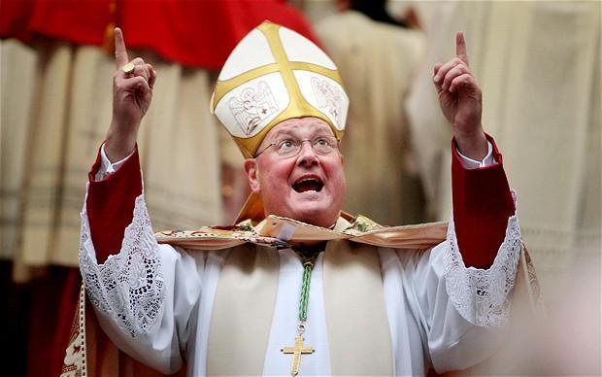
Health & Safety
Contraception mandate
Pharmacists denying emergency contraception
Medical neglect of children through faith healing
Notes:
A few top priorities:
Contraception mandate
Pharmacists denying emergency contraception
Medical neglect of children through faith healing

Slide 11
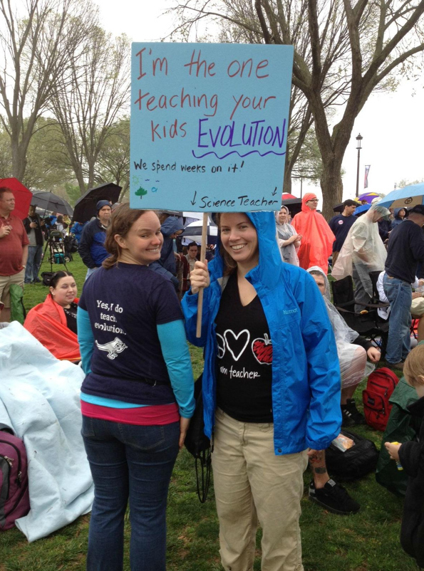
Education
Voucher programs
Abstinence-only sex education
“Creationism” and “Intelligent design” in science classrooms
Notes:
A few key issues in the area of Education are:
Voucher programs, send public money to religious schools
Abstinence-only sex education, religious influence on public school curriculum over research and basic science
“Creationism” and “Intelligent design” in science classrooms, dogma that religious zealots are calling to be presented as a theory in science classes, ignoring the lack of any actual science

Slide 12

Intelligent Design
Notes:
The earth is 4.6 billion years old. Yet creationists believe the earth is only 6,000 years old, and they are fighting to make sure your children learn this fallacy alongside scientific theories such as evolution-- in your public schools, with your tax dollars.

Slide 13
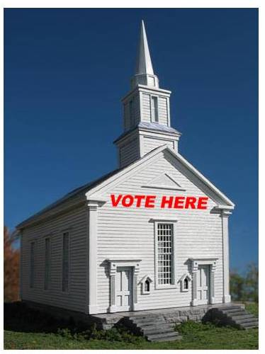
Religious Privileging Tax Policy
Houses of Worship endorsing candidates
Faith-Based Nonprofits are exempt from IRS reporting
Tax subsidies and exemptions for religious organizations
  $71 Billion
Notes:
Houses of Worship endorsing candidates, Faith-Based Nonprofits are exempt from IRS reporting
Tax subsidies and exemptions for religious organizations
$71 Billion a year,
[Source: How Secular Humanists (and Everyone Else) Subsidize Religion in the United States; Ryan Cragun, Stephanie Yeager, and Desmond Vega; Free Inquiry Magazine, May 2012]

Slide 14

Discrimination
Employer religious discrimination
Landlords violating discrimination laws may - using religion as a justification
Government issued marriage license requirements based on religious dogma
Adoption discrimination with federal $$$
Notes:
Employers religiously discriminating in hiring and firing,
Landlords violating discrimination laws may use religion as a justification
Government issued marriage license requirements based on religious dogma,
Used to be whites only, the wife was property, we moved from multiple wives, then allowed interracial marriage
It will happen
Forward March of Humanity
SCA works hard to fight this issues and more. We bring together all this movement and are your voice on capitol hill!

Slide 15











Secular Coalition for America
Member Organizations
Notes:
The Secular Movement came together over 10 years ago to have a united lobbying voice!
Need to recruit others! Who’s missing?

Slide 16
Unifying the Secular Movement – National Call
White House & Congress
Secular Events
Secular News
United Nations
Judicial Update
State Chapters
New Research
Coalition Expansion
Thursdays at Noon ET
Phone: 559-726-1300
Code: 199568
Notes:
We, at the Secular Coalition for America, realize that we create change by unifying this movement and reporting
Our National Secular Movement Weekly Update Call and newsletter is every Thursday at Noon ET. Phone number is here.
We cover the entire spectrum of government and secular issues:
Executive and Congressional Update
Secular Events and Calendar
Secular Movement in the News
Legislative and Regulatory Update
Judicial Update
State Chapters
Policy and Research Documents
Secular Coalition Expansion
Member Organization Announcements

Slide 17
Endorsing Organizations
Notes:
Go online and endorse us!
Helps when we are meeting with Decision Makers and their staff
Part of our aggressive campaign

Slide 18
SCA Success Measures
Notes:
Since Edwina Rogers joined the Secular Coalition for America as Executive Director in May of 2012, press mentions have increased by more than 270 percent.
During the 110 full months Ms. Rogers has headed the SCA (from May 2012-March 2013), the Secular Coalition received more than 267 media mentions, up from 67 media mentions in the preceding 10 months.
The actual number of press mentions is significantly higher than 267, because many stories were published in more than one publication, such as articles written by the Associated Press, which ran in several newspapers. (For example, a piece about the SCA’s California state chapter aired on KCBS FM 106.9 on 15 separate broadcasts, between the hours of 6:24 AM - 10:44 PM Local time, but this piece is counted as one mention. )
The Secular Coalition has been mentioned numerous times by the New York Times, Washington Post, and political news outlets such as the National Journal and Politico—publications it previously had no relationship with.
All of the media mentions listed have revolved around the promotion of SCA’s issues, initiatives, projects or general news of interest to the nontheist community.
If we are to continue this success we need you!

Slide 19
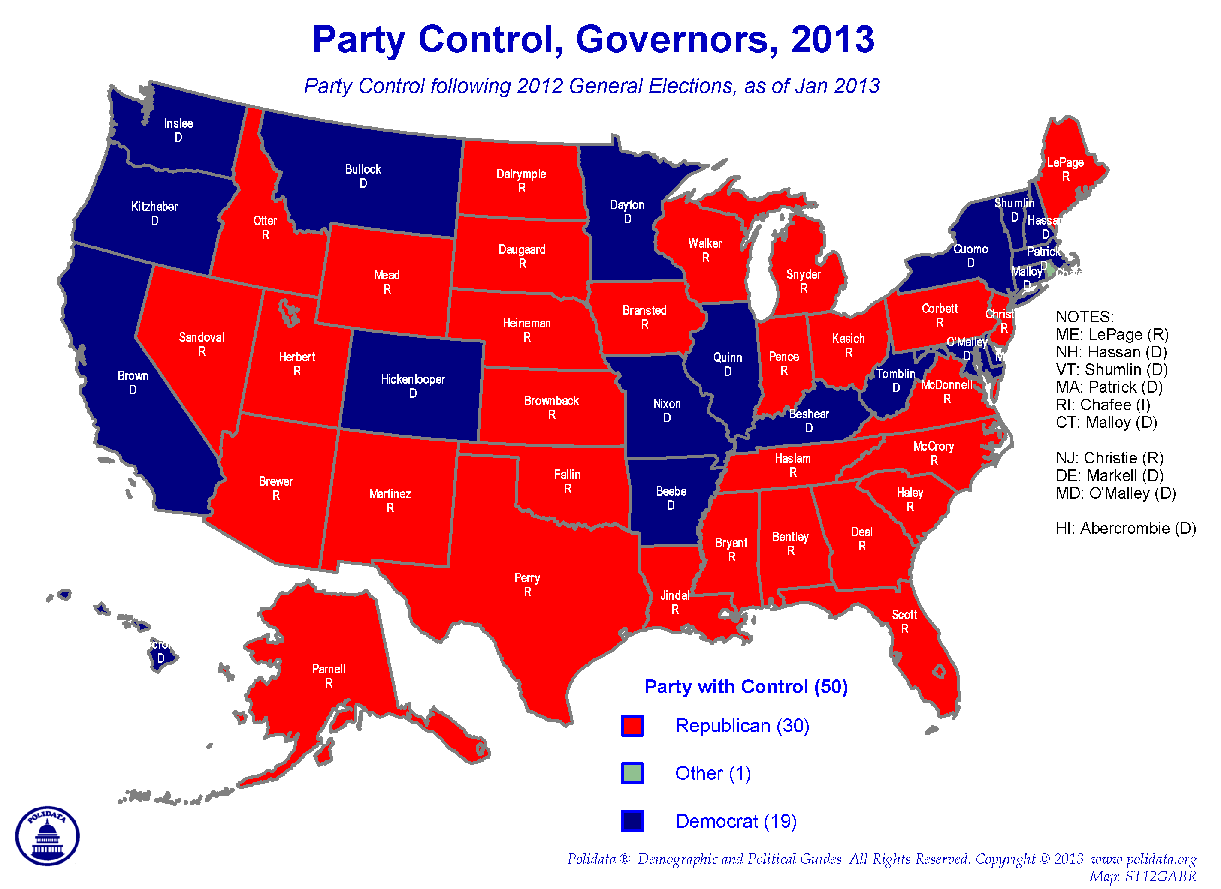
Notes:
Some of the most egregious violations of church state separation are being promoted and passed at the state level. Republican governors control 30 states in the US, meaning 60% of America. The Secular Coalition for America wants to be in every state to ensure that our issues are protected.

Slide 20
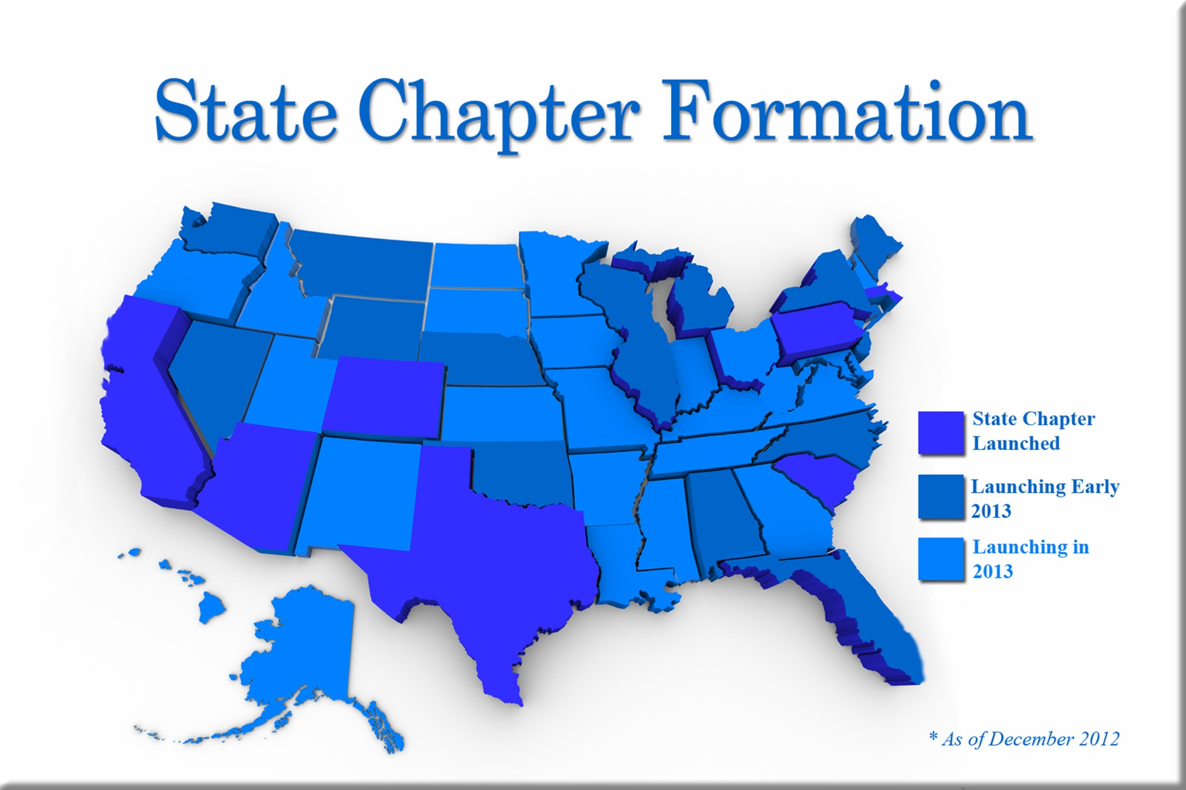
State Chapters
Notes:
Some of the most egregious violations of church state separation are being promoted and passed at the state level, A Secular Coalition for America state chapter is unlike any other nontheistic state organization—it brings together interested organizations and individuals for the exclusive purpose of lobbying .
Several state chapters now up and functioning.
SCA is organizing in all 50 states, but the end of 2013, there will be a chapter in each state. We want you to be a part of the Secular Coalition for your home state

Slide 21
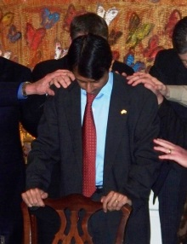
Religiously Motivated State Laws
6 - pharmacists can refuse to dispense emergency contraceptives
8 - do not inspect religious childcare centers
21 - exempt employers from contraceptive coverage
30 - ban all forms of marriage except one-man-one-woman
32 - sex education curricula not medically accurate
44 - require “under God” in Pledge of Allegiance
Prayer for Bobby Jindal (R-LA)
Notes:
These are a few examples of why we need state chapters:
6 - pharmacists can refuse to dispense emergency contraceptives
8 - do not inspect religious childcare centers
21 - exempt employers from contraceptive coverage
30 - ban all forms of marriage except one-man-one-woman
32 - sex education curricula not medically accurate
44 - require “under God” in Pledge of Allegiance

Slide 22
States Where Bible Curriculum Is Taught in Public Schools
Alabama Alaska Arizona Arkansas California Connecticut Florida Georgia Illinois Indiana Kansas Kentucky Louisiana | Maryland Massachusetts Michigan Minnesota Mississippi Missouri Montana Nebraska New Jersey New Mexico New York North Carolina North Dakota | Ohio Oklahoma Oregon Pennsylvania South Carolina South Dakota Tennessee Texas Virginia Washington West Virginia Wisconsin
Notes:
The Bible course curriculum has been voted into 687 school districts - 2,262 high schools - in 38 states.
93% of school boards that have been approached with this to date, have voted to implement it.
It is not just in the Bible belt, but it has been voted into school districts from Alaska and California, straight across the board to Pennsylvania and Florida.
Over 550,000 students have already taken our course nationwide.

Slide 23
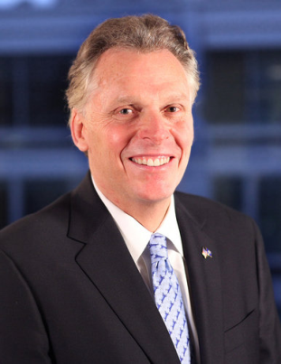
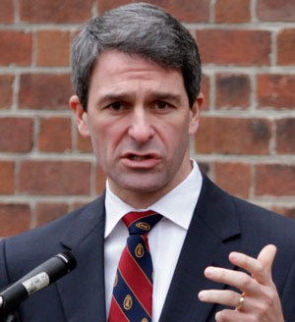
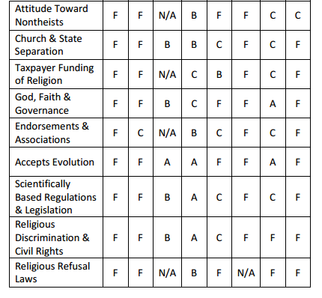
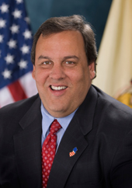
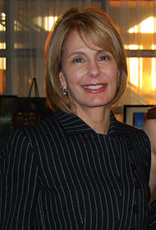
2013 Scorecards
Virginia –
New Jersey –
Terry McAuliffe
Ken Cuccinelli
Example:
Chris Christie
Barbara Buono

Slide 24
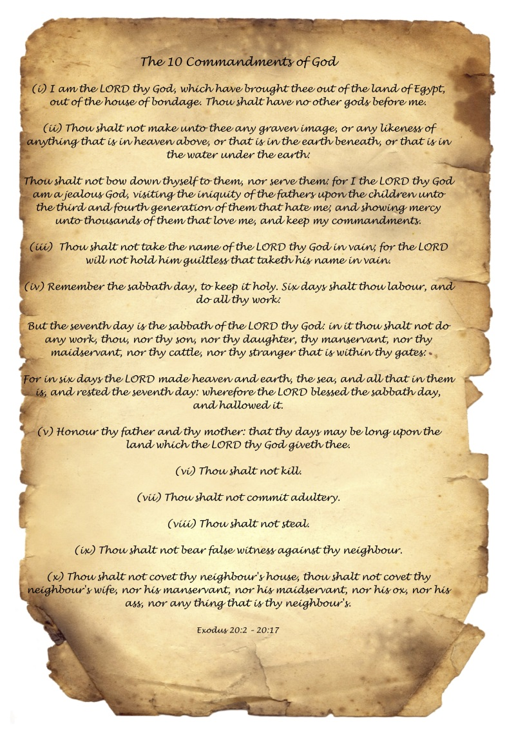
Federal Watch
HR 973 - "Religious Exemption to the Contraception Mandate"
HR 898 - "Religious Organizations Using Taxpayer Money without Limits"
HR 718 - Abstinence Education Reallocation Act of 2013
HR 127 - A bill to restore the Free Speech and First Amendment rights of churches and exempt organizations by repealing the 1954 Johnson Amendment
HR 23 - A bill to provide that human life shall be deemed to begin with fertilization.
S Res 11 - A resolution expressing support for prayer at school board meetings.
Notes:
HR 973 - "Religious Exemption to the Contraception Mandate" - A bill to exempt employers from any excise tax and certain suits and penalties in the case of a failure of a group health plan to provide coverage to which an employer objects on the basis of religious belief or moral conviction. Sponsor Rep. Sensenbrenner (R-Wis.), Introduced 3/5/13, referred to Committees on Education, Energy, and Ways and Means.
HR 898 - "Religious Organizations Using Taxpayer Money without Limits" A bill to authorize appropriations for fiscal 2014 through 2017 for the Trafficking Victims Protection Act of 2000, and for other purposes. Offending provision, sec. 303(a)(1)(B) which generally says faith based organizations receiving federal assistance shall not be required as a condition of receiving the assistance to utilize a program to which the organizations objects. Sponsor Rep. Smith (R-N.J.) Introduced 2/28/13, referred to Committee Energy and Commerce, Foreign Affairs, Judiciary, and Ways and Means
HR 718 - Abstinence Education Reallocation Act of 2013 - Sponsor Rep. Hultgren (R-Ill.) Introduced 2/14/13, referred to House Energy and Commerce Committee
HR 127 - A bill to restore the Free Speech and First Amendment rights of churches and exempt organizations by repealing the 1954 Johnson Amendment. Sponsor Rep. Jones (R-N.C.) Introduced 1/3/13, referred to House Ways and Means
HR 23 - A bill to provide that human life shall be deemed to begin with fertilization. Sponsor Rep. Broun (R-Ga.) Introduced 1/3/13, referred to House Judiciary Committee
S Res 11 - A resolution expressing support for prayer at school board meetings. Sponsor Sen. Vitter (R-La.) Introduced 1/23/13, referred to Senate Health, Education, Labor and Pensions Committee

Slide 25
Secular Policy Guide
With Co-Chairs Jacques Berlinerblau and Wendy Kaminer
Working with Academics, Policymakers, and Advocates
Providing Guidance to Policymakers On:
  Constitutional Framework
  Health and Safety
  Education
  Discrimination
  Military Discrimination
  Tax Policy
  International Policy

Slide 26

SCA Summit and Lobby Day
Notes:
Hundreds of secular supporters, representing millions of Americans, will stand together and be heard during the Secular Coalition for America's Lobby Day and Secular Summit. They will travel from across the country to Washington DC April 24 through 26 to discuss the issues that matter to them with federal government decision makers.
Thursday is the Secular Summit. Our panels will feature experts and decision makers from both the legislative and executive branch will discuss and defend decisions on topics of key importance to secular Americans in education, health and safety, tax policy, and discrimination.
Friday's Lobby Day kicks off with a training in best practices in lobbying, how to get politicians to listen and really create change. Each lobby day participant will meet with multiple offices, resulting in Secular Coalition supporters advocating secular issues in hundreds of legislative meetings in a single day.
The potential impact of our lobbying force cannot be overstated. 20% of this county is unaffiliated with any religion and the majority of Americans support a strong separation of religion and government. Yet the small but squeaky Christian Right wheel gets all the grease. Hundreds of people marching up the Capitol steps are hard to ignore. We have the numbers, but we must speak up together. Lobby Day is our chance to impress upon our elected officials that we are organized, informed, and we will show up. Show your government you will no longer be ignored, attend the Secular Coalition for America's Lobby Day and Secular Summit. The Hyatt Regency Washington on Capitol Hill is where Secular Summit speakers and secular leaders are staying, and where major DC politicians walk the lobby between "off the hill" meetings.

Slide 27

MAKE A DIFFERENCE
Vote and hold your local politicians accountable
Get involved in your local Secular Coalition Chapter
Stand up and be heard as a fearless #secularwarrior
Text “secular” to 41444 to pledge a donation to the Secular Coalition for America Today!

Slide 28
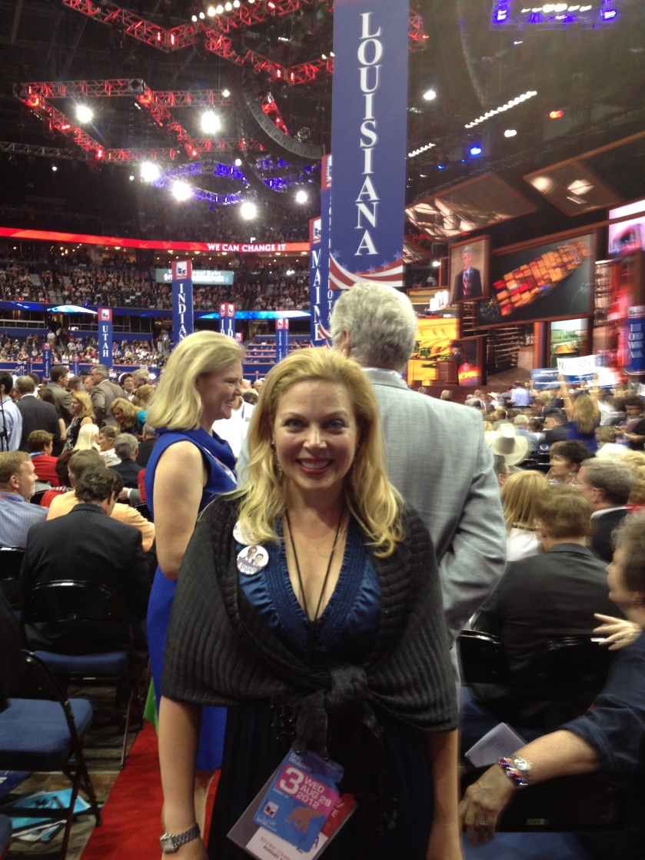
Speaker Information
Edwina Rogers
Executive Director
Mobile (202) 674 7800
Edwina@secular.org
Secular Coalition for America
1012 14th St., NW, Suite 205
Washington, DC 20005
Office (202) 299 1091 ext. 207
www.secular.org
Notes:
What is the answer to this serious threat to our most basic freedom?
Freedom of thought and Conscience
Stop being a polite extremist
Join the Secular Movement to take back America

